Slide 2
Introduction
It’s the week of Thanksgiving and you realize how fast Christmas is approaching. You haven’t made any shopping lists and don’t really think you have the money to shop this year. However, you know that you can’t show up without gifts. You look at your account and you have $300 discretionary income available in your checking account. You also have a MasterCard credit account with an available credit line of $2,000. To save money, you’ve decided to get your shopping done on Black Friday. Shopping on Black Friday in the stores and online will definitely save you money.

Slide 3
Rules & Guidelines
$300 discretionary income in checking account
Have an available credit limit of $2,000 on your MasterCard
Must shop for your:
Mother
Father
Brother
Sister
Best Friend
Must spend at least $100 on each person
Must buy from at least 3 stores
Must use at least one coupon
Must buy at least one item at a discount – percentage (%) off
Sales Tax is 8.25% for all stores

Slide 4
Day 1 & 2 - Shopping
Monday & Tuesday

Slide 5
Shopping List
Christmas Shopping List
For | Item | Store | Qty | Item Price
Ex: Mrs. Jefferson | iPad Mini | Wal-Mart | 1 | $299.99

Slide 6
Receipt Directions
Target Stores
123 Any Street
Anytown, TX 77777
(210) 555-1234
Item |  | Price
Razor Scooter—Pink |  | $34.99
Rise of the Guardians DVD |  | $19.99
Mr. Coffee Coffee Pot |  | $24.88
Coupon on Mr. Coffee product ($10 OFF)
Item Total |  | $79.86
- Discount |  | $10.00
Subtotal |  | $69.86
Sales Tax |  | $5.76
Total |  | $75.62
Thank You!
Draw the logo
Fill in the store name, address, and phone number (it’s okay to make it up)
Write in each item on its own line with a good description of the item you are buying
On the item’s line, write in the item price
If you are using a coupon or taking advantage of a discount, write it in at the bottom of the receipt
Calculate “Item Total”, “Discount” (if necessary), “Subtotal”, “Sales Tax”, & “Grand Total”

Slide 7
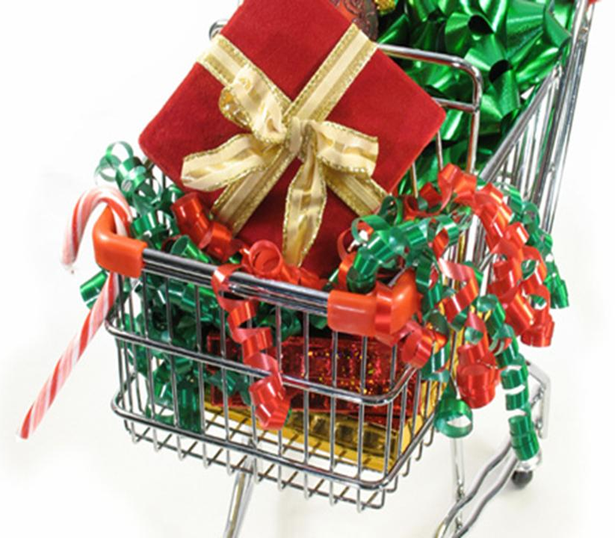
Deliverables
Due Tuesday at end of class period
Shopping list, complete with all gifts to buy for all 5 people
At least 3 store receipts with correct calculations
Remember to
Use one coupon, and
Take advantage of a percentage off discount

