Slide 1
My Reality Check Project
Mrs. Jefferson
All Periods

Slide 2
Introduction
Overview of Project
Education & Employment
Income & Deductions
Housing
Transportation
One-Time Expenses
Monthly Income & Expenses
Monthly Budget
Reflection

Slide 3
Overview of Project
Preparation for life
Understand what’s needed to be successful in life after high school
Find employment
Find housing
Find transportation
Furnish my home
Create a monthly budget
We were told:
It is 2017! You are graduating soon and your parents just informed you that you must move out after graduation. Thankfully, your parents have given you a $2,000 graduation gift and a loving, good luck wish! You must decide how you will handle this new information while keeping in mind that you only hold a high school diploma and have no work experience.

Slide 4
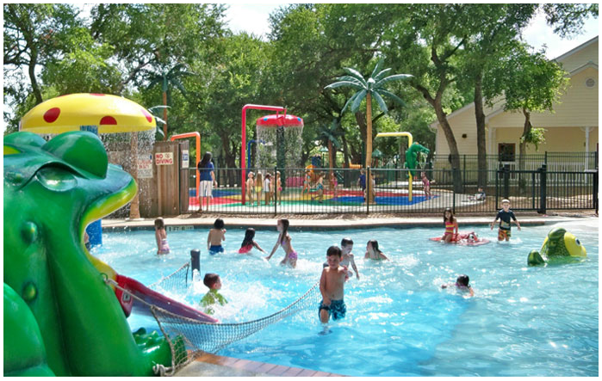
Education & Employment
High School Graduate
Monster.com
Country Home Learning Center
Daycare Teacher
7611 Leslie Road San Antonio, TX 78253

Slide 5
Income & Deductions
$9.50 per hour
Gross Income
$380.00 per week
$1,646.67 per month
$19,760.00 per year
Deductions
Federal Withholding: $247.00
Social Security: $102.09
Medicare: $23.88
Monthly Net Income: $1,273.70

Slide 6
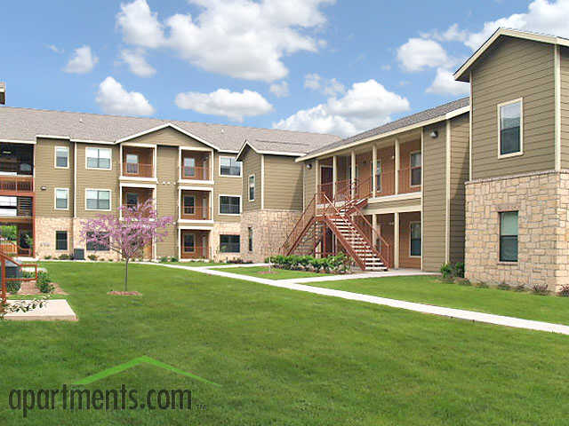
Housing
Brynwood
8711 Bowens Crossing San Antonio, TX 78250
Apartments.com
Close to work

Slide 7
Transportation
VIA Public Transportation
Cheapest method
Monthly Pass: $35.00

Slide 8
One-Time Expenses
Expense | Total Amount
Housing: Deposit | $100.00
Transportation: Bicycle Cost | $0.00
Transportation: Bicycle Accessories | $0.00
Home Furnishings | $1,785.26
Total One-Time Expenses | $1,885.26
Parent’s Graduation Gift of $2,000.00
Furniture
Kitchen Stuff
Bathroom Décor
Bedroom Décor

Slide 9
Monthly Income & Expenses
Income: $1,273.70
Expenses: $1,271.83
Gross Monthly: $1,646.67
Monthly Deductions: $372.97
Net Monthly: $1,273.70
Housing: $615.00
Transportation: $35.00
Electric: $52.83
Water: $11.00
Phone: $85.00
Cable/Internet: $75.00
Food: $250.00
Entertainment: $25.00
Medical: $73.00
Miscellaneous: $50.00

Slide 10
Monthly Budget
Expense | My Share | %
Housing | $615.00 | 47%
Transportation | $35.00 | 3%
Total Utilities | $223.83 | 18%
Food | $250.00 | 20%
Entertainment | $25.00 | 2%
Medical | $73.00 | 5%
Miscellaneous | $50.00 | 4%
Savings | $1.87 | 1%
Total | $1,273.70 | 100%
Creating a budget was hard
At first, I was over budget.
Lower cable & internet bill
Chose cheaper cell phone plan

Slide 11
Reflection
A LOT!!!
Advice: Make sure you budget correctly and have a good job.
Budgeting is very important.
It’s very easy to spend more money than you make.
Having a budget is helpful, so that I don’t go into debt.
If I didn’t know how much I made, I wouldn’t be able to live on my own!

Slide 12
The End

