Slide 1
Bell Ringer – Who Am I? Read the following and respond in your journals.
I am your constant companion. I am your greatest helper or heaviest burden. I will push you onward or drag you down to failure. I am completely at your command. Half the things you do, you might as well turn over to me and I will be able to them quickly & correctly.
I am easily managed—you must merely be firm with me. Show me exactly how you want something done and after a few lessons I will do it automatically. I am the servant of all great individuals and, alas, of all failures, as well. Those who are great, I have made great. Those who are failures, I have made failures.
I am not a machine, though I work with all the precision of a machine plus the intelligence of a human. You may run me for a profit or run me for ruin—it makes no difference to me.
Take me, train me, be firm with me, and I will place the world at your feet. Be easy with me and I will destroy you.

Slide 2
Habits
Mrs. Jefferson – Dollars & Sense

Slide 3
Bell Ringer – Who Am I? Read the following and respond in your journals.
I am your constant companion. I am your greatest helper or heaviest burden. I will push you onward or drag you down to failure. I am completely at your command. Half the things you do, you might as well turn over to me and I will be able to them quickly & correctly.
I am easily managed—you must merely be firm with me. Show me exactly how you want something done and after a few lessons I will do it automatically. I am the servant of all great individuals and, alas, of all failures, as well. Those who are great, I have made great. Those who are failures, I have made failures.
I am not a machine, though I work with all the precision of a machine plus the intelligence of a human. You may run me for a profit or run me for ruin—it makes no difference to me.
Take me, train me, be firm with me, and I will place the world at your feet. Be easy with me and I will destroy you.

Slide 4
I am Habit!
Definition:
A constant, often unconscious inclination to perform an act, acquired through its frequent repetition

Slide 5
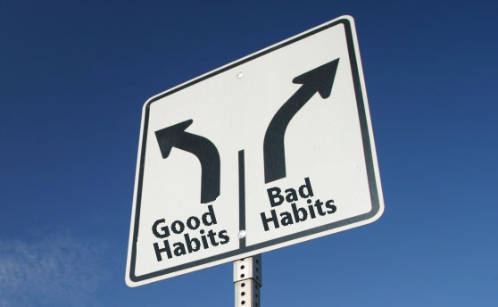
Habits Can Make or Break You
Good Habits
Bad Habits
Good habits can help you be successful
Bad habits can detract from your success

Slide 6
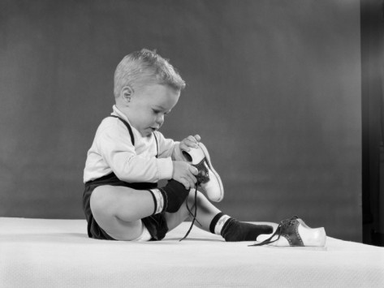
Habits Can Make or Break You
Some habits just are…
Don’t help you
Don’t hurt you
Example:
Putting your right shoe on first

Slide 7
Changing Habits
Not easy to change a habit, but it’s possible
Cross your arms over your body
Which arm is on top?
Now switch your arms and cross them the other way
How does it feel?
Fold them the wrong way for 30 days and it would become a habit

Slide 8
Group Work Assignment
Fold your team’s paper into thirds (see picture)
Label each column
Good Habits
Not Good or Bad Habits
Bad Habits
As a team, come up with 5 habits for each category
When complete, turn into Turn-In Bin

